Slide 1
SMART HOME SYSTEM WITH INTEGRATED
SECURITY FEATURES AND SUPPORT FOR THE DEAF AND ELDERLY PEOPLE
Presented By : Ann Martin, Keerthana, Ankit kumar
Reg no (8BTCS)
Department of Computer Science and Engineering
Guide : Bijesh T V
2016-2017-March

Slide 2
Agenda
Abstract (optional)
Introduction
Architecture or block diagram (optional)
Existing System/ liturature survey
Proposed System
Design Modules
Future Work and Time Line
References

Slide 3
Project idea
Door Alert with integrated smart home system to control appliances from anywhere
Security, health and automation is the scope of our project.

Slide 4
Introduction
We have 3 module in our project
First is “DAD” (Door Alert System For Deaf), suppose deaf person inside home if guest comes and rings the bell that person who is inside is not able to hear anything. We have design a system that will alert that person if someone comes near to the door, one device carry by deaf person will vibrate and if the person is not in home, he will get the message on his phone that visitor arrive along with visitor image from cloud.

Slide 5
In second module is health purpose.
One wrist size device will be wear by person, if his/her pulse is low or high red and green led will blink simultaneously. If the pulse is normal is normal only green led will blink.
All the data will store in database as

Slide 6
Third module is for controlling home appliances from anywhere using internet connection
If the user is out of town and he forget to switch his/her home’s appliances such as light, fan etc. as he out of town its not possible to switch off the appliances from other part of place. So we design a system based on IOT using this system he can control any appliances from any part of the world using mobile application or computer’s browser.

Slide 7
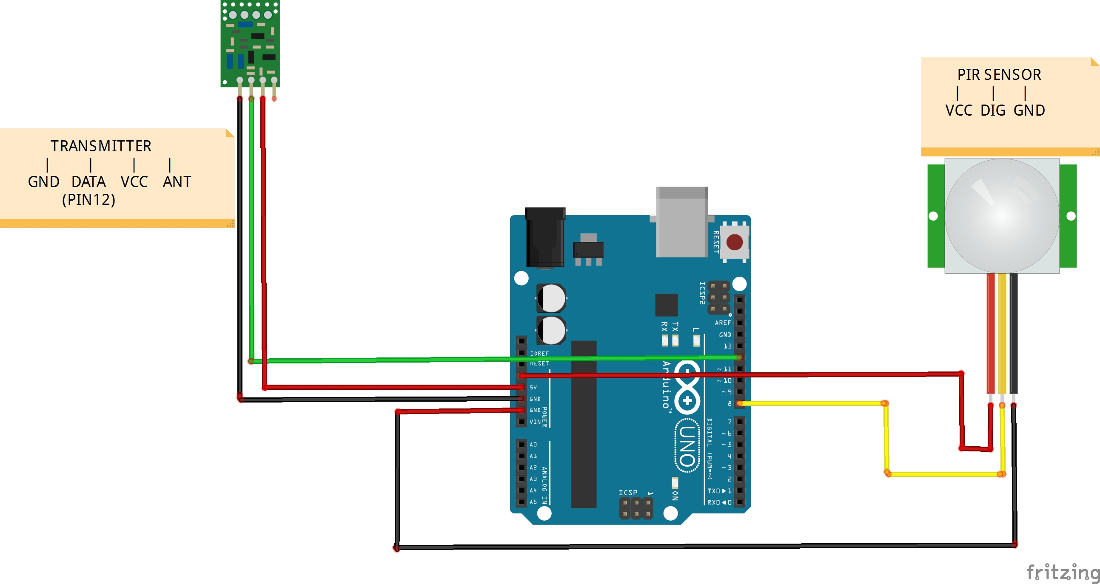
Architecture Of DAD
Transmitter

Slide 8
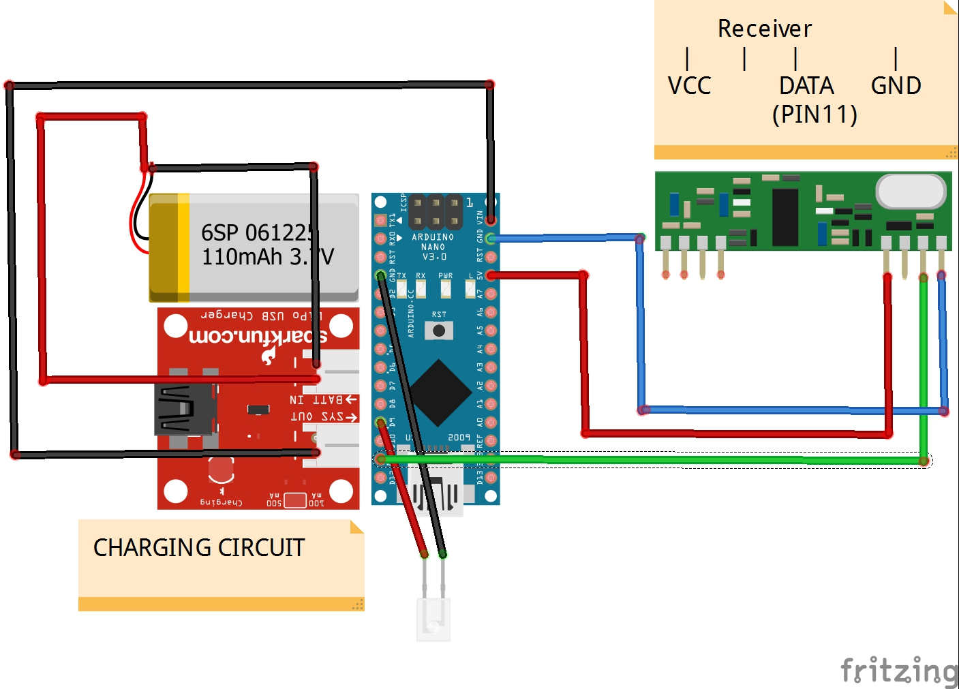
Architecture Of DAD
Receiver

Slide 9
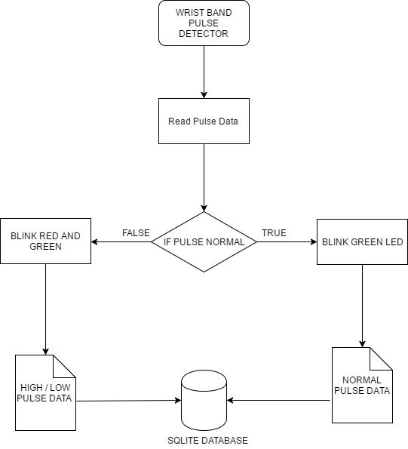
Flow Chart Of Low / High Pulse Detection

Slide 10
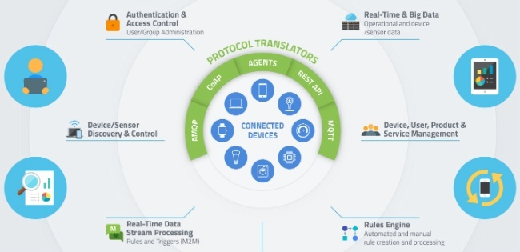
Architecture Of Smart Home System

Slide 11
Protocol Used in Smart Home System
MQTT : MQTT (MQ Telemetry Transport or Message Queue Telemetry Transport) is an ISO standard (ISO/IEC PRF 20922) publish-subscribe-based "lightweight" messaging protocol for use on top of the TCP/IP protocol.
CoAP : Constrained Application Protocol (CoAP) is an Internet Application Protocol for constrained devices. ... CoAP is also being used via other mechanisms, such as SMS on mobile communication networks. CoAP is an application layer protocol that is intended for use in resource-constrained internet devices, such as WSN nodes.

Slide 12
Protocol Used in Smart Home System
AMQP : The Advanced Message Queuing Protocol (AMQP) is an open standard application layer protocol for message-oriented middleware. The defining features of AMQP are message orientation, queuing, routing (including point-to-point and publish-and-subscribe), reliability and security.
Agents: The Agent Extensibility Protocol or AgentX is a computer networking protocol that allows management of Simple Network Management Protocol objects defined by different processes via a single master agent. Agents that export objects via AgentX to a master agent are called subagents.

Slide 13
Protocol Used in Smart Home System
REST API: REST stands for Representational State Transfer. (It is sometimes spelled "ReST".) It relies on a stateless, client-server, cacheable communications protocol -- and in virtually all cases, the HTTP protocol is used

Slide 14
Existing System
We have integrated our three module in one system prototype.
Disadvantages
Not Much secured
Battery Consumption is more
Without internet connectivity no use
RF Module can catch too much noise which cause inproper output

Slide 15
Problem introduction(problem Statement from literature survey) can be explained.

Slide 16
Proposed System
Proposed System in the Project………..
Advantages as per proposed system………….

Slide 17
Design Modules
Should explain the modules of the project in detail…..

Slide 18
Computational Model
(implementation model)
In what method the problem is solved?
with Clear explanations…………
It can be based on the project may have 1 or more slides..

Slide 19
Experimental Result
Experimental result with graphs

Slide 20
Algorithm
Algorithms used In the project with neat explanation………(If project having algorithm)
Tools used
Methods used

Slide 21
Sample Screen shots
Sample screen shots on project…

Slide 22
Future Enhancement
Future enhancement based Dissertation work………….

Slide 23
conclusion
Conclusion of the topic based on the Dissertation……..

Slide 24
References
It includes the websites,ieee journal titles, books,etc………

